Slide 1
An Expert System to identify Classes of Bragging in social media according to their characteristics
Marufa Sultana
ID:18701008
Session:2017-18
Department of Computer Science & Engineering
University of Chittagong

Slide 2
Introduction
Sharing information is widely used in everyday communication on social media, where individuals attempt to establish a positive opinion of themselves either directly or indirectly.
Bragging is one of the most common techniques of communication.
Involves highlighting good quality about the speaker through positive statements for creating a favorable self-image by self-disclosing, self-promotion and self representation in social circles

Slide 3
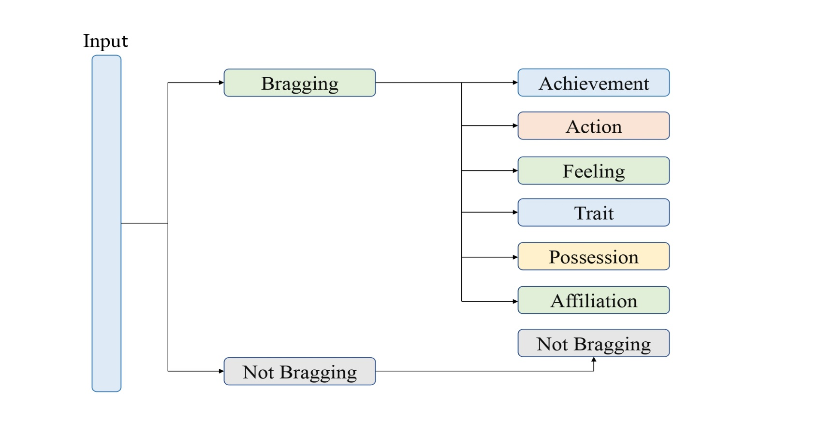
Problem Statement
The task’s main objective is Finding informative texts connected to bragging or not bragging.

Slide 4
Aims and Objectives of The Project
Identify the classes of bragging in social media.
Separate the bragging according to their characteristics.
Able to detect bragging for specific class by comparing their characteristics.
Helps to self disclosing according to the situation to maintain social circle peacefully.
Helps to reduce negatively and violence by Identify and classify of bragging as well as beneficial for public safety personnel for decision making.

Slide 5
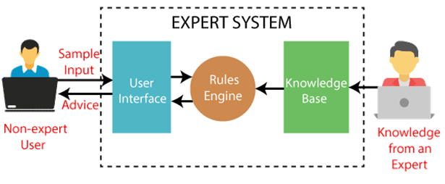
Architecture of our system
Expert system, designed to solve complex problems and to provide decision-making ability.
Extracting knowledge from its knowledge base using the reasoning and inference rules according to the user queries.
Mainly consists of 3 components.
User Interface
Inference Engine
Knowledge Base

Slide 6
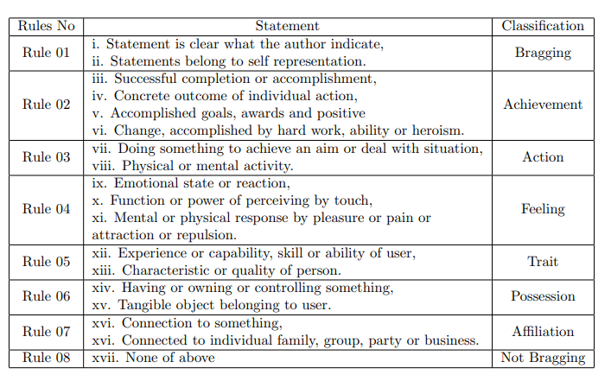
System Production Rule

Slide 7
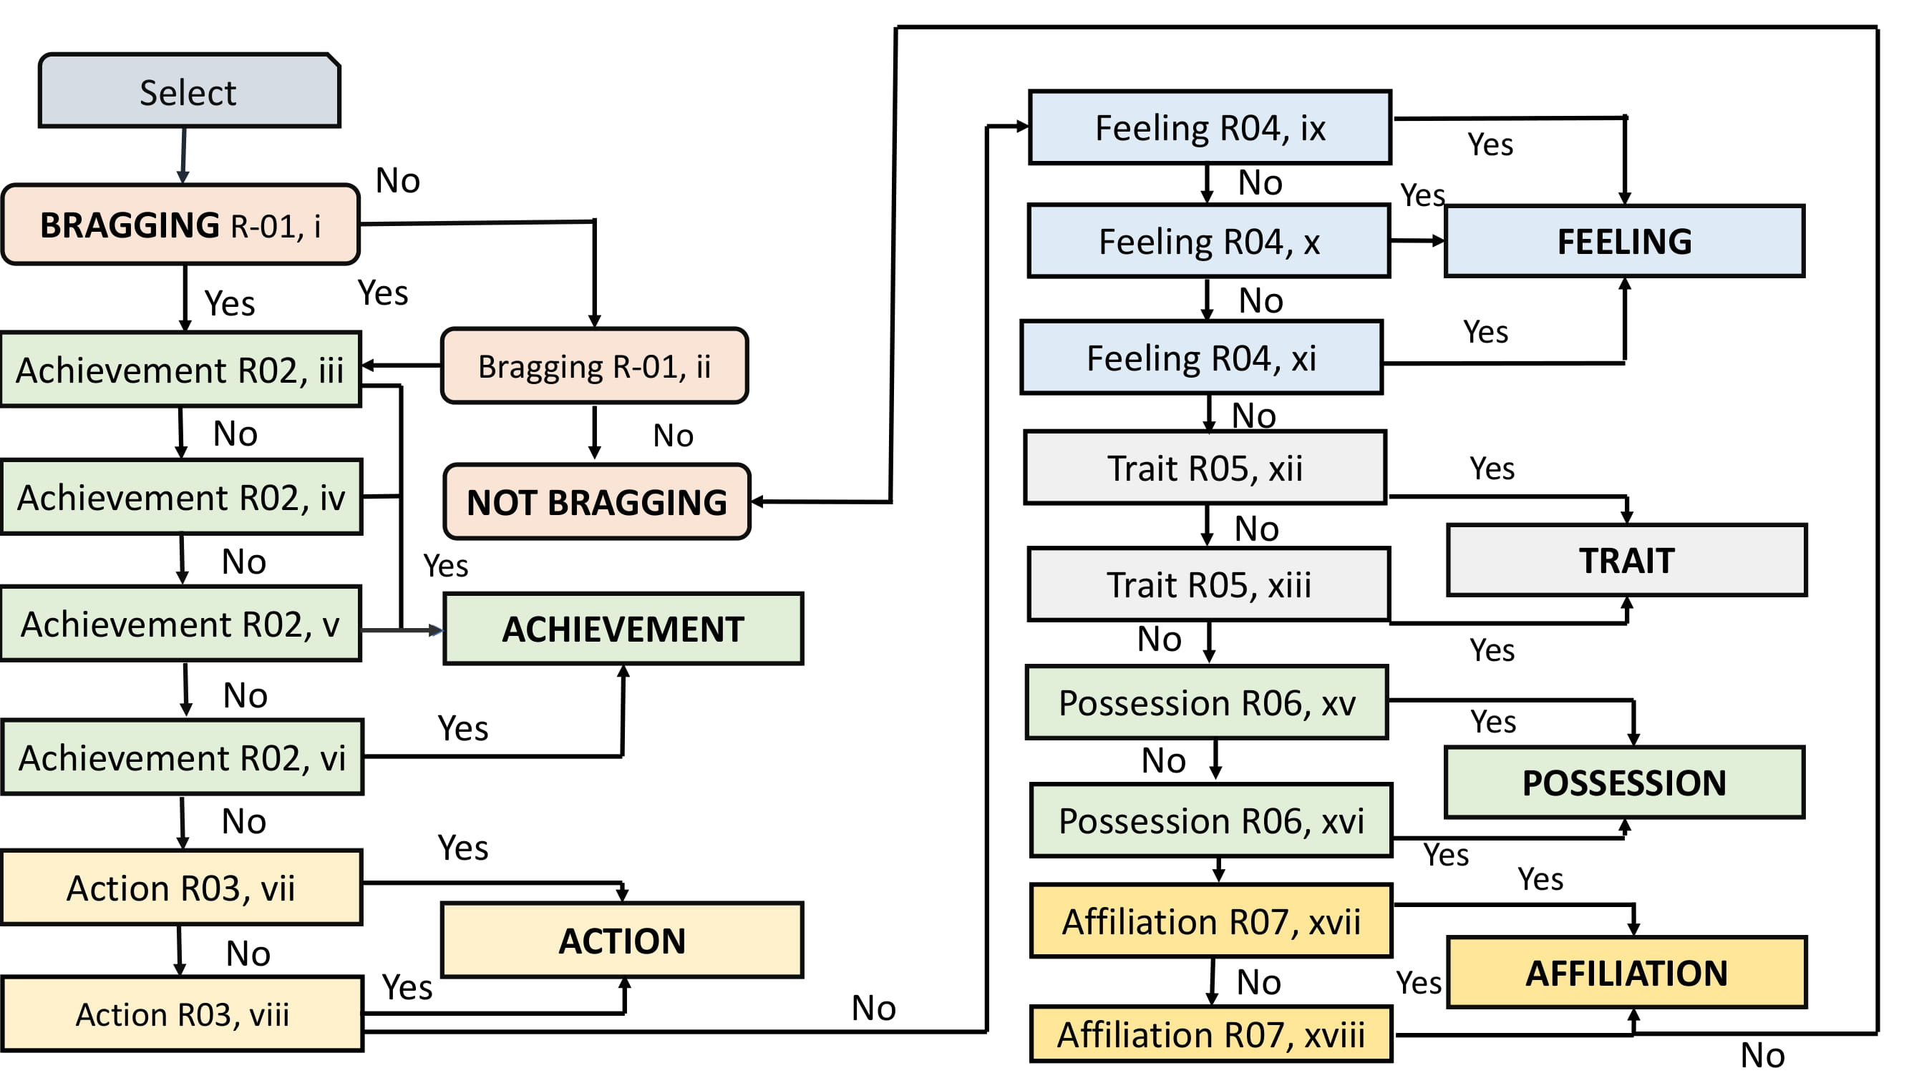
Design of our system

Slide 8
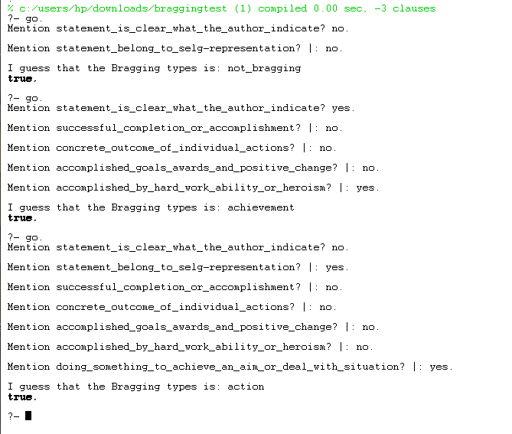
Snapshot of the system

Slide 9
Conclusion
An expert system made successfully.
Prolog is best suited for developing this kind of expert system.
Helps to know about the types of bragging in social media.

Slide 10


